Slide 1


Samsung ARTIK™ Demos
Nov 2018

Slide 2
CES 2018
Demo | Use Cases | Featured Products
ARTIK device management/development cycle | - Demonstrate fast, easy and secure onboarding of ARTIK devices - LWM2M base device management / OTA solutions - ARTIK software development cycle by using ARTIK SDK. - Onboard an ARTIK 0x devices by using ARTIK reference mobile app - Generate newer firmware image using ARTIK IDE/SDK for 05x - Push the updated image to edge nodes from ARTIK Cloud services. | 053S, 055S, 02, 03
IoT Interoperability | - How ARTIK cloud service bridge devices, services like Amazon Echo, Philips Hues, LaMetric etc. by using Normalized data and Orchestration Engine. - Show interoperability at the application layer - Showcase how we can use Edge solution to enable bridging technology for the layers below. | 530, 710
Ignis Infrared Camera | Real life application of ARTIK sensors (device for fire emergency workers to see through smoke) | 710
Legrand - Display and logos | Highlight partnerhip with Smart lighting controls (radiant collection) "Guest Room of the Future" project | ARTIK platform

Slide 3
Embedded World 2018
Industry 4.0 Asset Monitoring and Virtualization: Demonstrates new PTC, ARTIK integrated solution with Shoreline iCast 2 IoT Bridge. Harman and RushUP gateways also available.
Interoperable Smart Building: Harman solution for building automation including intelligent workspaces and improved asset utilization. Will also show ARTIK-enabled gateway solution for industrial applications.
Artificial Intelligence: A proof-of-concept demonstrating ARTIK 710s SoM capabilities to enable AI and Machine learning on affordable edge devices. Ideal for applications like object recognition for security cameras, factory quality control, and more.
ARTIK End-to-End Solutions: The latest capabilities of the ARTIK platform and integrated cloud services demonstrated with Alexa interoperability and the seamless creation of scenes using a range of 3rd party devices.

Slide 4
Partner Demos @ CES and MWC 2018
Embedded World
Seeed Eagleye 320 Dev Kit (will be available at their booth; announcement RushUP KITRA GTI Internal PCB (ARTIK 053 SoM) and motor, and LED remote control enabled via Industrial Gateway on ARTIK 530 (ARROW)
Beck industrial solutions will show a “Fog node” edge device, powered by ARTIK 710 controlling a robot arm in near “real time” using smart phone gesture control connected through the cloud. An ARTIK-enabled browser panel will provide a digital twin, visualization and analytics. (EBV)
Mobile World Congress
Greenwave Systems is running AXON PredictTM on ARTIK 530 SoM. Powerful edge analytics and sophisticated data management, allow autonomous responses on device in realtime
MultiTech will announce a new Samsung Starter Kit integrating MultiConnect Dragonfly embedded Cellular SoM with ARTIK IoT SoMs to provide developers with a cellular LTE Cat 1 solution for IoT

Slide 5
AppNote Wall Demo

Slide 6
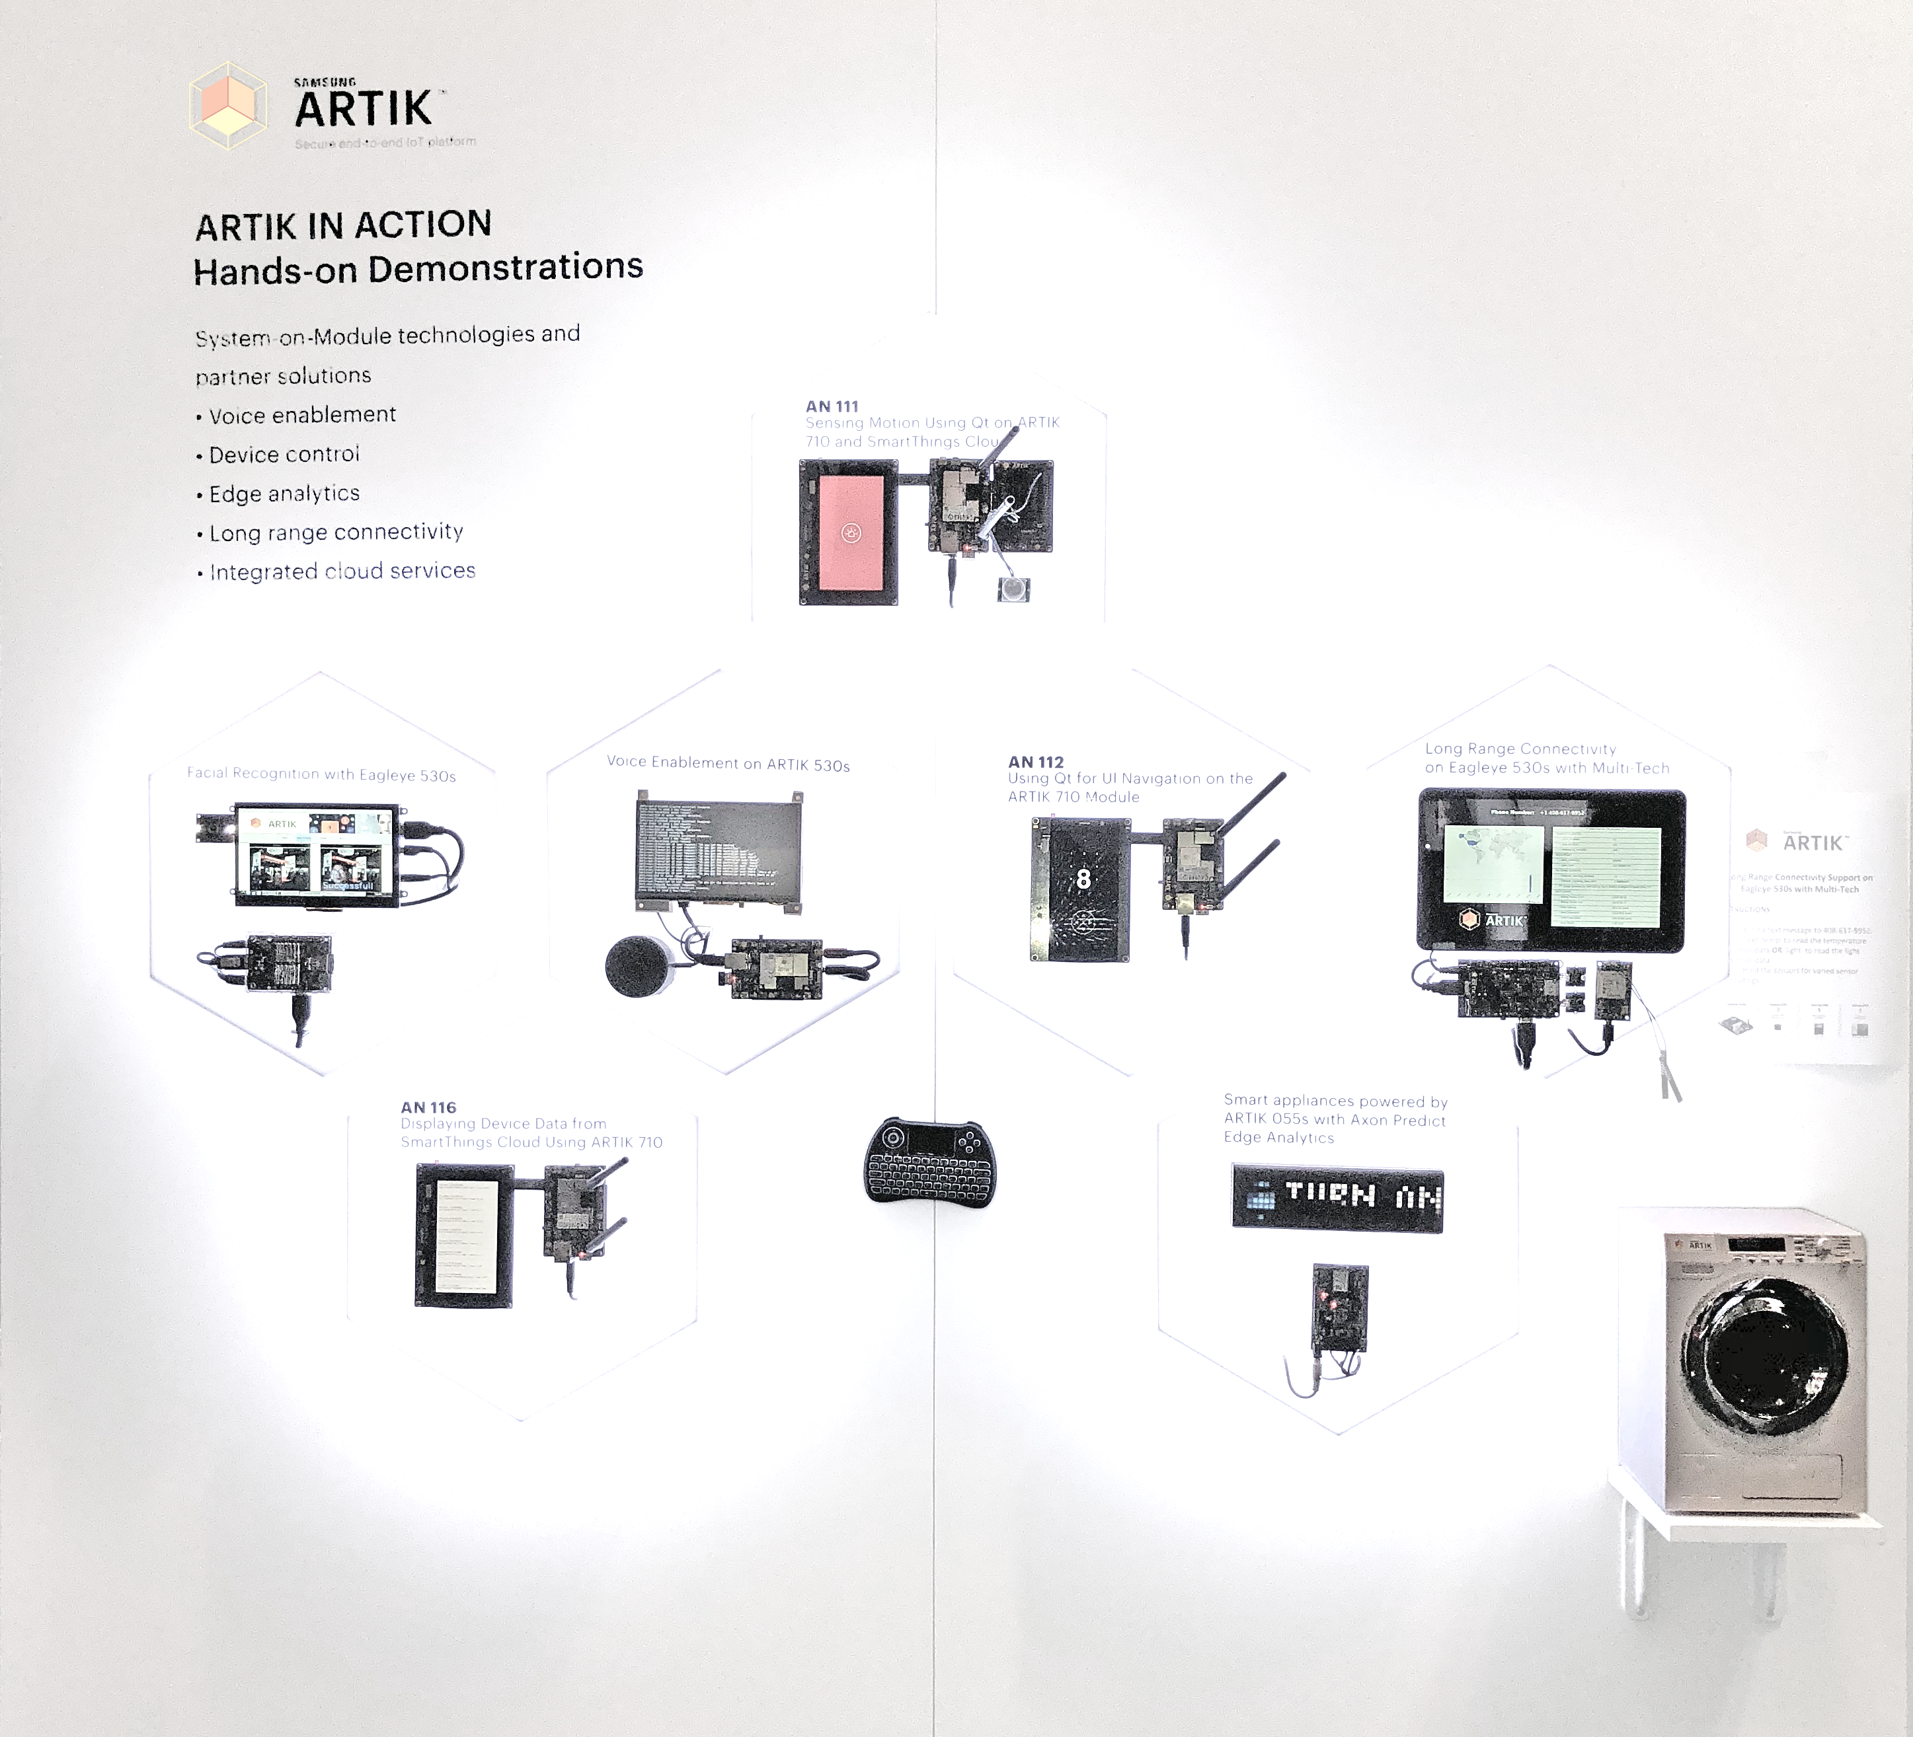

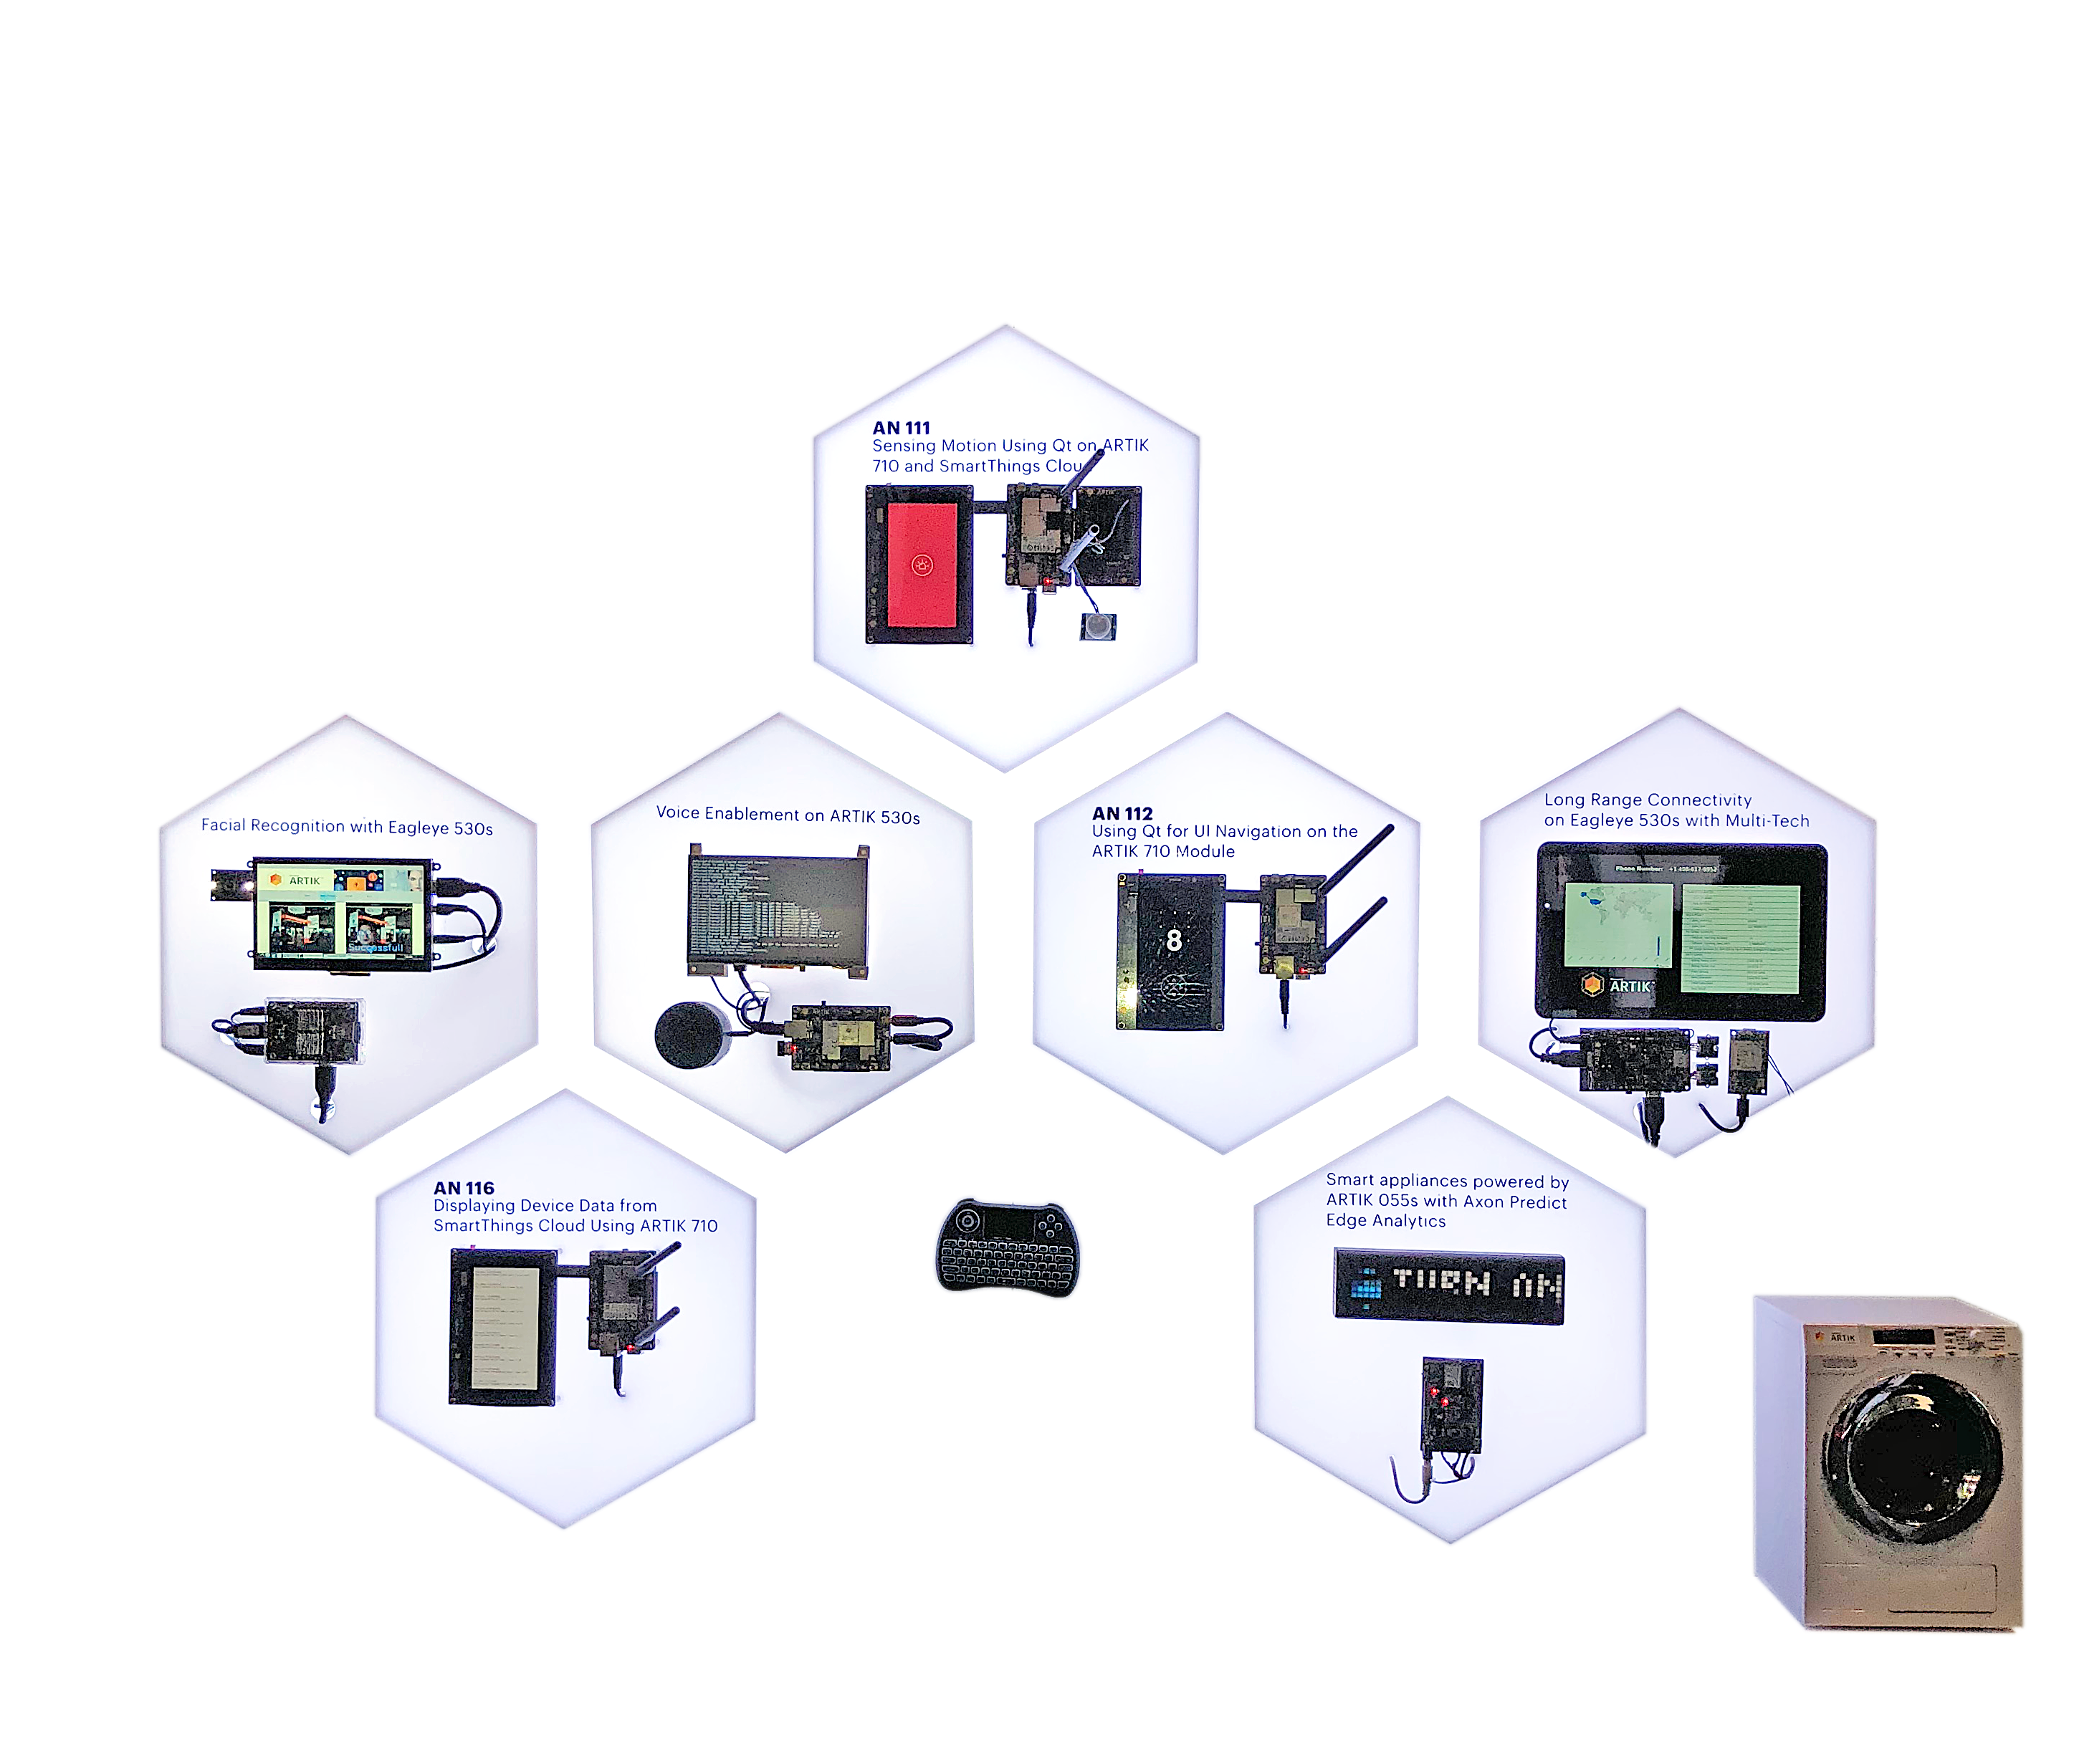
ARTIK IN ACTION Hands-on Demonstrations
System-on-Module technology and
partner solutions
Voice enablement
Device control
Edge analytics
Long-range connectivity
Integrated cloud services
(IoT World 2018)

Slide 7
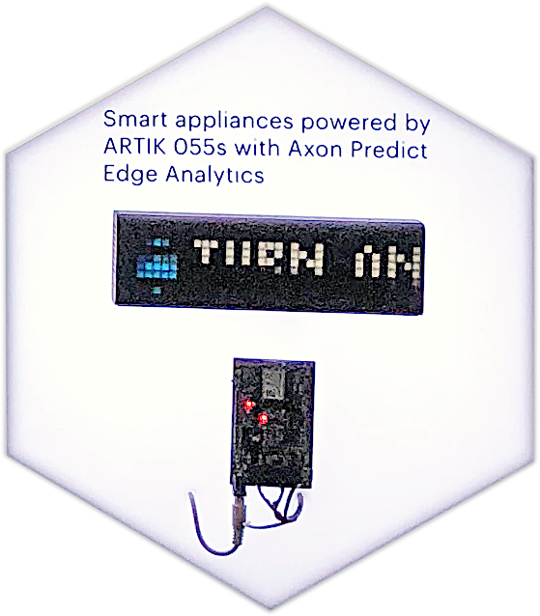
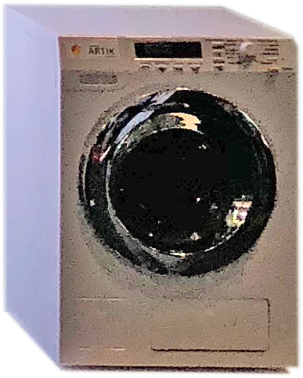
Smart Appliances and Edge Analytics ARTIK 055s SoM and Axon Predict Edge Analytics
ARTIK 055s-powered smart washer with edge analytics for detergent level check, predictive maintenance, etc. Washer can be controlled by a mobile app or voice. Alerts shown on LaMetrics display.
Use case: Smart home appliances, Smart building - HVAC, boilers. Smart building and factory gateways (using other ARTIK modules)
Hardware: ARTIK 055s WiFi module, washer with weight sensor, water level sensor etc., (optional) mobile device, LaMetrics display
Software: SmartThings Cloud cloud connector, rules engine; Android mobile app; AXON Predict Analytics

Slide 8
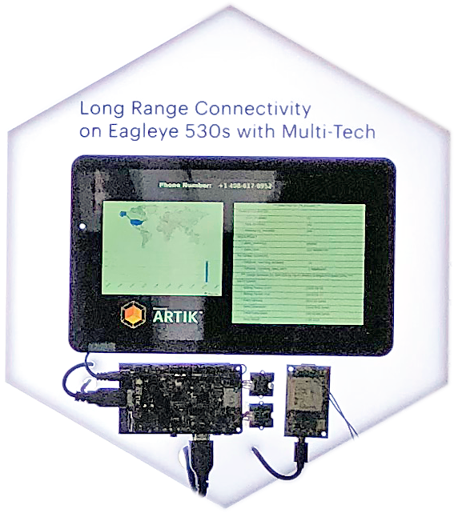
Long-range Connectivity Seeed Eagleye 530s with Multi-tech
Provide LTE support on Eagleye530s with Multi-tech modem and Twilio SIM. Send a text message to Twilio phone number and receive real-time readings from sensors attached to Eagle530s.
Use case: Smart city, remote data transmission and monitoring systems, freight management
Hardware: Eagleye530s, Multi-tech modem, Twilio SIM card, GrovePi+ Starter Kit and sensors, (optional) screen LCD
Software: Twilio APIs, Qt for UI

Slide 9
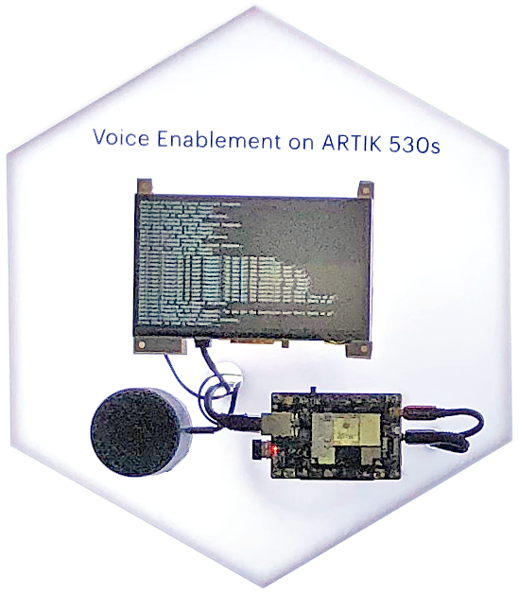

Voice Enablement ARTIK 530s SoM and Google Assistant
Run Google Assistant or Amazon AVS on ARTIK530s. Use voice commands to control peripherals or sensors attached to ARTIK.
Use case: Voice-controlled gateway, home and building products
Hardware: ARTIK 530s, speaker, (optional) LCD
Software: Google Assistant SDK or Alexa Voice Service Device SDK. Can develop additional Google Actions or Alexa skills to extend basic capabilities.

Slide 10
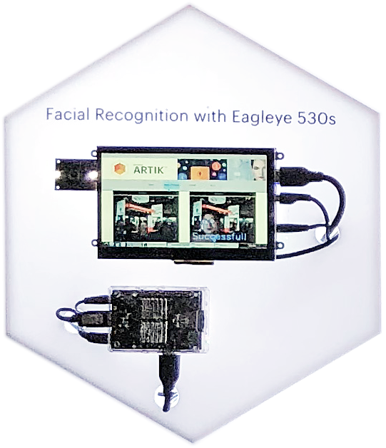
Facial Recognition Security Camera Seeed Eagleye 530s
Uses Eagleye530s and camera accessories for facial recognition. Non-enrolled faces will trigger alerts. Motion detection and video capture can be enabled.
Use case: Home surveillance, access control system
Hardware: Eagleye530s, OV5640 5M Auto Focus USB camera, 10.1” PCAP Touch Screen LCD, GrovePi+ Starter Kit and sensors
Software: GrovePi APIs, OpenCV, Kairos face recognition APIs

Slide 11
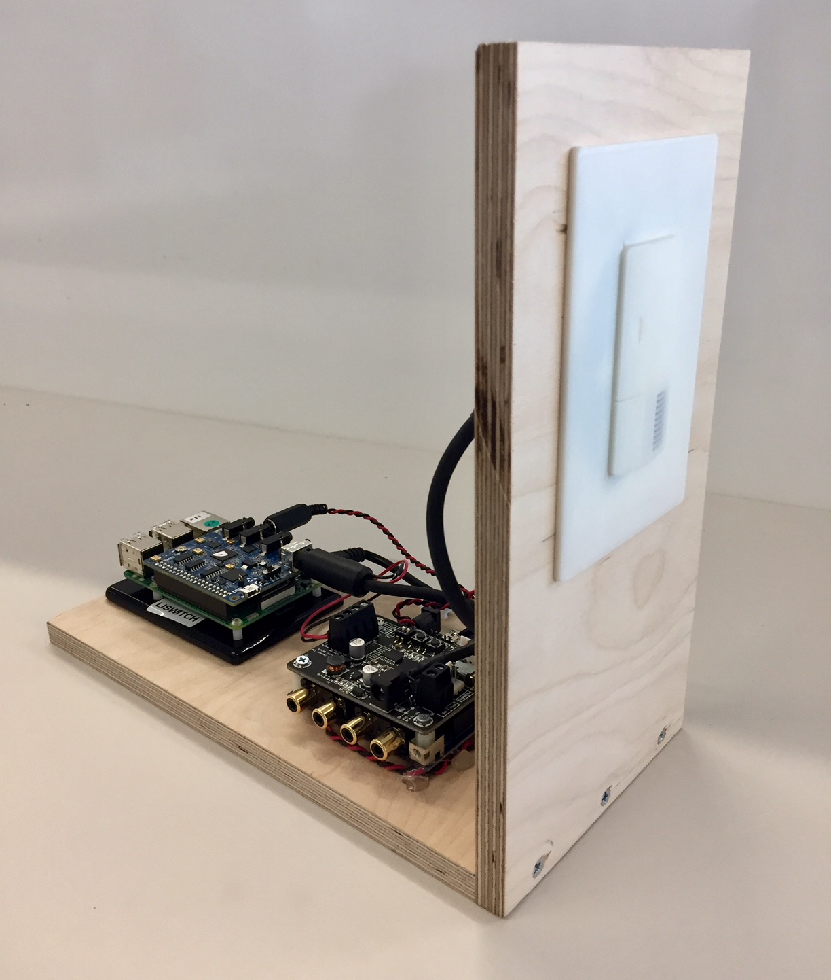
Voice-enabled Intelligent Switch ARTIK 05x, ARTIK 530 SoMs and AVS Gateway
State-of-the-art voice control combined with machine learning provides personalized experiences, including predictive lighting and automatic vacation mode.
Use case: Smart Home, Smart Building, Hospitality (hotel)
Hardware: ARTIK05x, ARTIK 530 for AVS connectivity , Voice detection using Synaptics DSP
Software: Alexa Voice Service on 530, 05x sensor logic, control logic on 05x, ARTIK Cloud connectivity via 530

